Slide 1
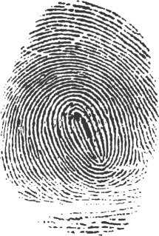
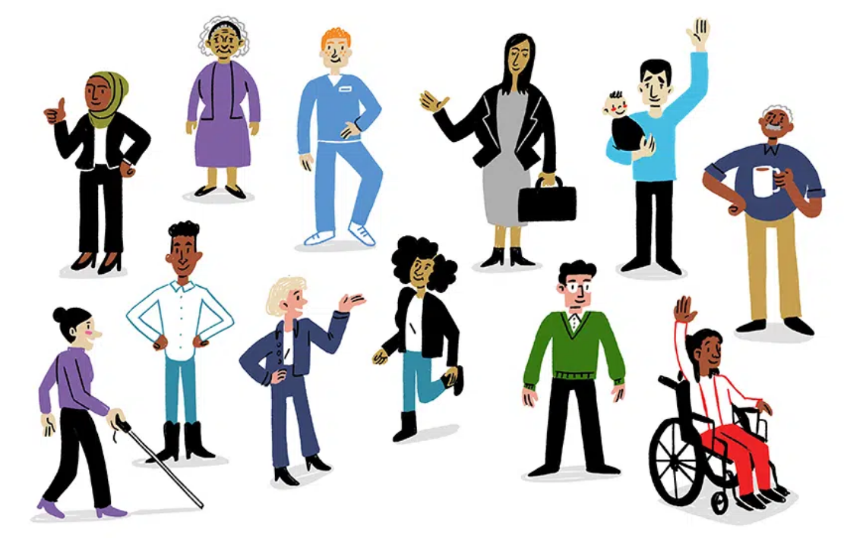
Everyone has a unique identity. No two people are exactly alike.
Our identities are formed by intrinsic and extrinsic factors.
How you view yourself changes all the time.
Ink factory studio

Slide 2
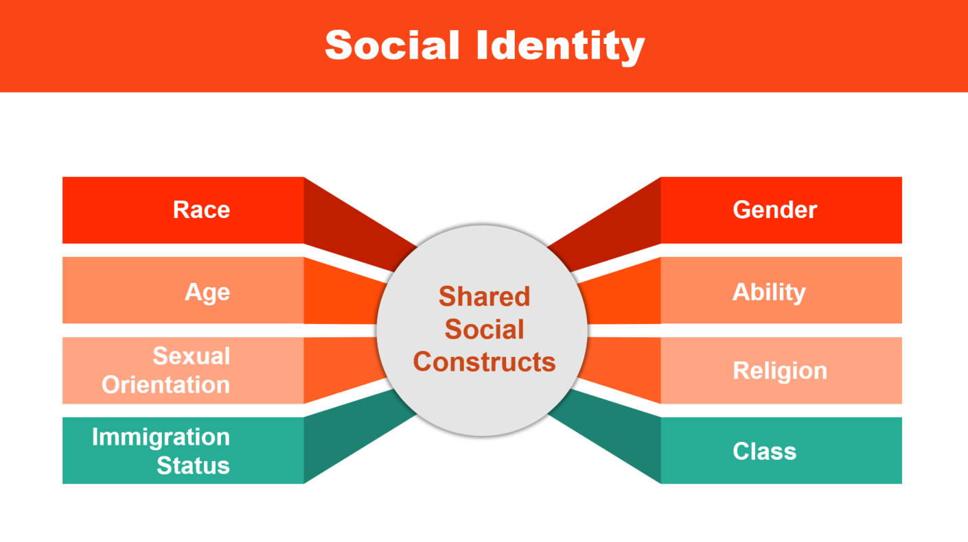
We all also have social identities.
Social identities are categories based on shared social constructs.
Social identities are often at the root of unequal power or privilege.
Social identities also lay the foundation for bias, stereotypes, prejudice, and favoritism

Slide 3
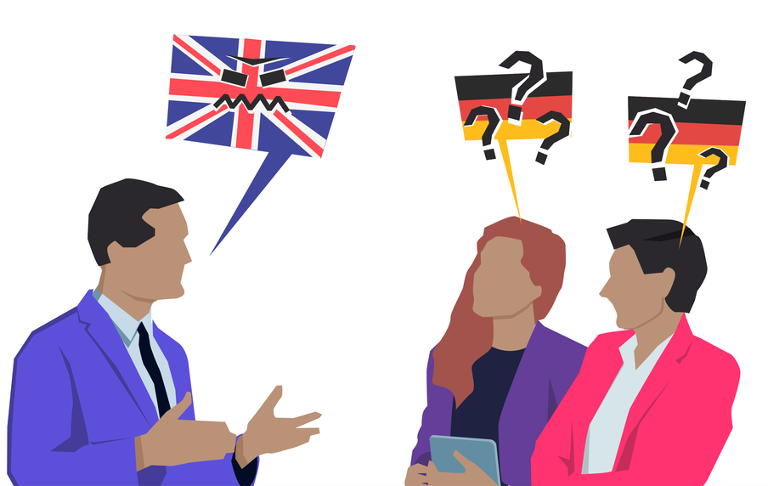
The impact of social identities is contextual
Example: In the US and UK, the academic calendar has breaks at Easter and Christmas. What if you celebrate Lunar New Year and Ramadan with your family?
Example: Language proficiency is context dependent. English as a first language is a great help in science, but doesn’t help in many countries.

Slide 4
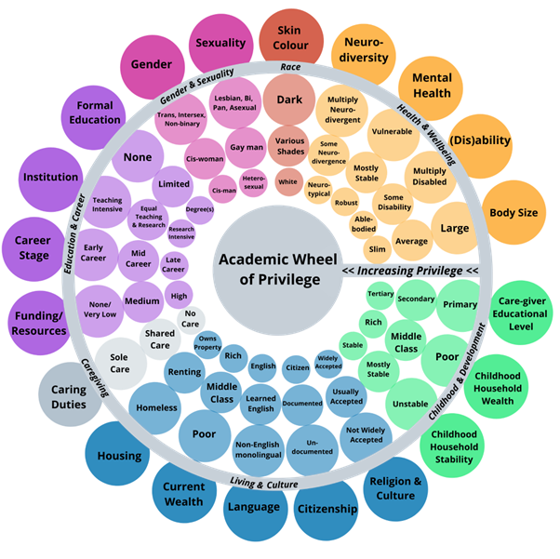
The impact of social identities is contextual
Example: In the UK, the academic calendar has breaks at Easter and Christmas
Example: Language proficiency is context dependent
Reproduced under CC-BY Attribution 4.0 International from Elsherif, M. M., Middleton, S. L., Phan, J. M., Azevedo, F., Iley, B. J., Grose-Hodge, M., Tyler, S., Kapp, S. K., Gourdon-Kanhukamwe, A., Grafton-Clarke, D., Yeung, S. K., Shaw, J. J., Hartmann, H., & Dokovova, M. (2022). Bridging Neurodiversity and Open Scholarship: How Shared Values Can Guide Best Practices for Research Integrity, Social Justice, and Principled Education. MetaArXiv https://doi.org/10.31222/osf.io/k7a9p

Slide 5
Mark where you are on each axis of identity.
Reproduced under CC-BY Attribution 4.0 International from Elsherif, M. M., Middleton, S. L., Phan, J. M., Azevedo, F., Iley, B. J., Grose-Hodge, M., Tyler, S., Kapp, S. K., Gourdon-Kanhukamwe, A., Grafton-Clarke, D., Yeung, S. K., Shaw, J. J., Hartmann, H., & Dokovova, M. (2022). Bridging Neurodiversity and Open Scholarship: How Shared Values Can Guide Best Practices for Research Integrity, Social Justice, and Principled Education. MetaArXiv https://doi.org/10.31222/osf.io/k7a9p

Slide 6
Mark where you are on each axis of identity.
Which categories are most important to your sense of self (how you think of who you are).
Which categories have had the greatest positive impact on your success in science?
Which categories have had the greatest negative impact on your success in science?
Reproduced under CC-BY Attribution 4.0 International from Elsherif, M. M., Middleton, S. L., Phan, J. M., Azevedo, F., Iley, B. J., Grose-Hodge, M., Tyler, S., Kapp, S. K., Gourdon-Kanhukamwe, A., Grafton-Clarke, D., Yeung, S. K., Shaw, J. J., Hartmann, H., & Dokovova, M. (2022). Bridging Neurodiversity and Open Scholarship: How Shared Values Can Guide Best Practices for Research Integrity, Social Justice, and Principled Education. MetaArXiv https://doi.org/10.31222/osf.io/k7a9p

Slide 7
Discussion guidelines
Participate respectfully
Listen to understand and learn
Uphold confidentiality – don’t share someone else’s story
Reproduced under CC-BY Attribution 4.0 International from Elsherif, M. M., Middleton, S. L., Phan, J. M., Azevedo, F., Iley, B. J., Grose-Hodge, M., Tyler, S., Kapp, S. K., Gourdon-Kanhukamwe, A., Grafton-Clarke, D., Yeung, S. K., Shaw, J. J., Hartmann, H., & Dokovova, M. (2022). Bridging Neurodiversity and Open Scholarship: How Shared Values Can Guide Best Practices for Research Integrity, Social Justice, and Principled Education. MetaArXiv https://doi.org/10.31222/osf.io/k7a9p

Slide 8
Paired discussion (8 min)
Take turns sharing how your social identities positively and negatively have impacted (are impacting, will impact) your career as a scientist.
Reproduced under CC-BY Attribution 4.0 International from Elsherif, M. M., Middleton, S. L., Phan, J. M., Azevedo, F., Iley, B. J., Grose-Hodge, M., Tyler, S., Kapp, S. K., Gourdon-Kanhukamwe, A., Grafton-Clarke, D., Yeung, S. K., Shaw, J. J., Hartmann, H., & Dokovova, M. (2022). Bridging Neurodiversity and Open Scholarship: How Shared Values Can Guide Best Practices for Research Integrity, Social Justice, and Principled Education. MetaArXiv https://doi.org/10.31222/osf.io/k7a9p

Slide 9
Group discussion (7 min)
As you feel comfortable, share insights from this activity and your discussions.
Please raise your hand to be called on.
Reproduced under CC-BY Attribution 4.0 International from Elsherif, M. M., Middleton, S. L., Phan, J. M., Azevedo, F., Iley, B. J., Grose-Hodge, M., Tyler, S., Kapp, S. K., Gourdon-Kanhukamwe, A., Grafton-Clarke, D., Yeung, S. K., Shaw, J. J., Hartmann, H., & Dokovova, M. (2022). Bridging Neurodiversity and Open Scholarship: How Shared Values Can Guide Best Practices for Research Integrity, Social Justice, and Principled Education. MetaArXiv https://doi.org/10.31222/osf.io/k7a9p

Slide 10

Paired discussions
Read the case study assigned to your breakout room, then answer the following questions
What identities / intersections do you notice?
How does the structure of academia exclude them based on their identities?
Implications for mentoring – how would you mentor this person? What resources are available for them? If you don’t know, how would you find out?
Case studies and discussion questions

Slide 11
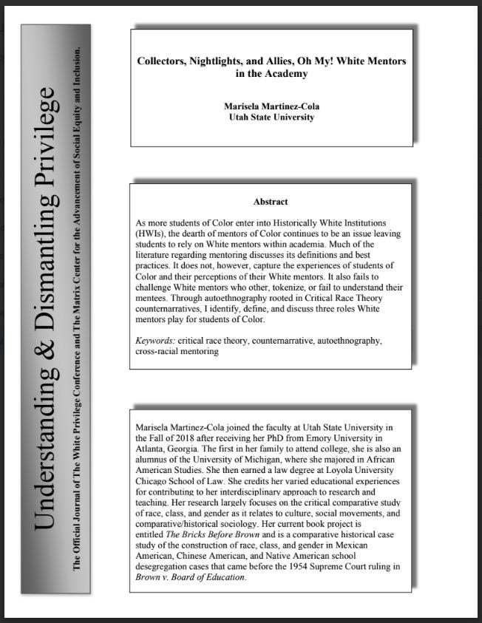
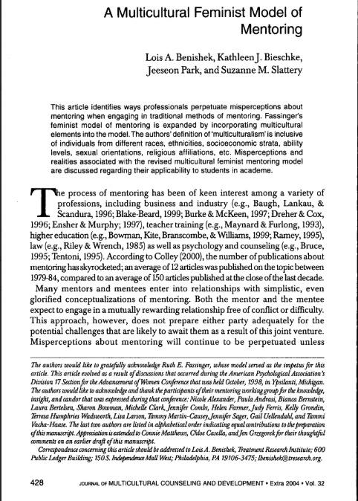
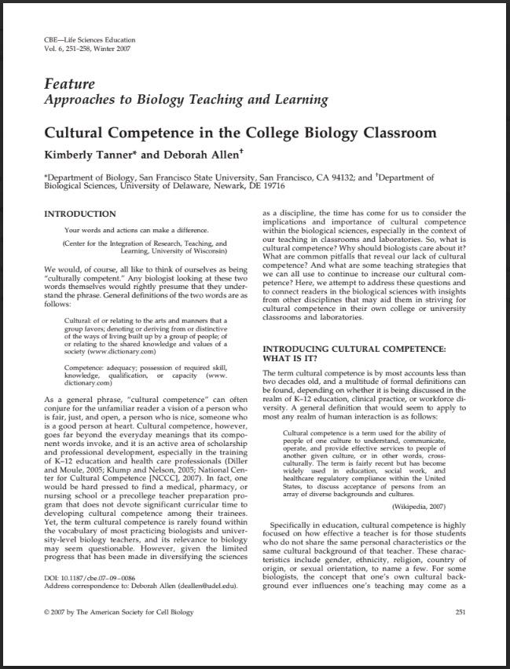
Next week’s pre-work: Sign up for 1 of 3 reading options (aiming for 3 ~ equal groups):
Option #1 (16 pages)
Option #2 (14 pages)
Option #3 (7 pages)
Martinez-Cola (2020)
Benishek et al. (2004)
Tanner & Allen (2007)
How do students of Color perceive their White faculty mentors? (Autoethnography)
How is a Multicultural Feminist Model (MFM) of Mentoring different from traditional mentoring and how can it be used to improve mentoring relationships with mentees different from yourself?
What is Cultural Competence, why should biologists care about it, and how can college biology teachers develop cultural competence?

